Slide 1


Song Sentiment Toolset Results
Kent Roller

Slide 2

Project Refresher
Overall goal is to find viable option to perform sentiment analysis on songs
Threshold is set at 85% accuracy or higher
Service is not critical, so high degree of initial accuracy is not a strict requirement
Using Taylor Swift as the artist due to several presumptions about content
Ground truth labels were acquired by referring to SME

Slide 3
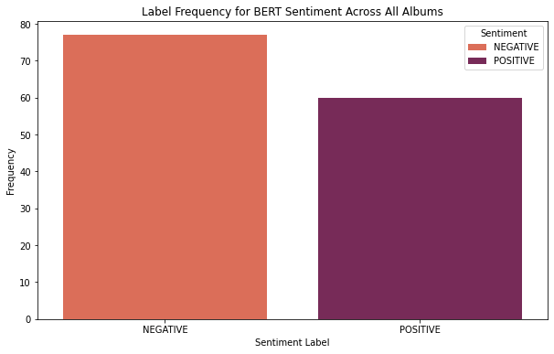
Previously…
Performed Sentiment Analysis on data using BERT and Google’s© GoEmotion®
In both cases, initial barplots were misleading as they indicated similar outcome to frequency barplots
However, frequency counts are not the same as pairwise comparisons
The highest accuracy achieved was ~66% for Binary labels and ~23% for Intermediate Labels
Barplot of label frequency using BERT on lyric data

Slide 4
Next steps
Since the Sentiment Analysis tools provided unfavorable performance, maybe we can turn to models for higher performance.
From here, the following models were compared across both Binary and Intermediate labels, and both 10-Fold CV and Leave One Out CV were used for calculating accuracy for the models used:
Multinomial Naïve Bayes
Linear SVC
SVC w/Linear Kernel
Random Forest

Slide 5
Multinomial Naïve Bayes
In the table above, the results for the multinomial naïve bayes models can be seen.
10-Fold and Leave One Out Cross Validation was used for both the Binary and Intermediate Labels.
The highest accuracy achieved with MNB is 56.20% with the Binary labels and 27.58% with the intermediate labels.
This performance is unfortunately below the threshold we will move on to the next model.

Slide 6
SVC and Linear svc
Here we can see the results table for both the SVC model using the linear kernel and the LinearSVC model.
Some uplift in performance is present, with a high of 65.77% accuracy for the Binary Labels.
The Intermediate labels also perform slightly higher than when compare to the sentiment analysis with a high of 30.71%.
This is however still a far cry from the goal of 85% for either label class

Slide 7
Random Forest
Model Type | Label Set | CV Method | Accuracy
Random Forest | Basic/Binary +cstm stopwords | 10-Fold | 61.26%
Random Forest | Basic/Binary +cstm stopwords | LOO | 58.40%
Random Forest | Basic/Binary + English stopwords | 10-Fold | 56.87%
Random Forest | Basic/Binary +English stopwords | LOO | 57.67%
Random Forest | Basic/Binary +GridSearchCV | 10-Fold | 65.00%
Random Forest | Basic/Binary + cstm stopwords v2 | 10-Fold | 58.35%
Random Forest | Basic/Binary + cstm stopwords v2 | LOO | 58.40%
Random Forest | Intermediate + cstm stopwords | 10-Fold | 29.90%
Random Forest | Intermediate +cstm stopwords | LOO | 22.63%
Random Forest | Intermediate + optimal hyperparameter | 10-Fold | 29.12%
Random Forest | Intermediate + optimal hyperparameter | LOO | 26.28%
Random Forest | Basic/Binary + cstm stopwords v3 | 10-Fold | 57.58%
Random Forest | Basic/Binary +cstm stopwords v3 + optimal hyperparemter | 10-Fold | 62.71%
Here we can see the results table for the Random Forest Models.
The first pass was made using a custom stop words list as opposed to the NLTK English stop words list.
This initial pass performed slightly higher at 61.26% vs 56.87% for the NLTK stop words.
The highest pass was found using gridsearch on several parameters which yielded a performance of 65%.
The highest performing manually tuned model came in under this at 62.71% using a further customized stop words list.

Slide 8
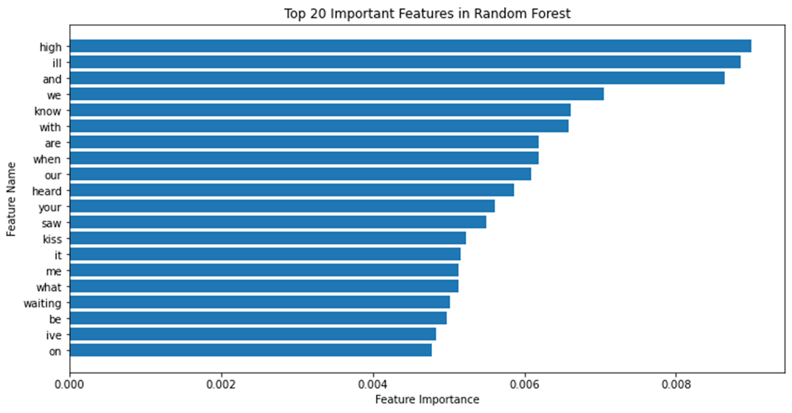
Searching for performance loss
The barplot shows the top 20 most important features in the random forest model.
Many of the words being selected as high value features have little emotional connotation such as “and” or “it”, but are still ranked highly regardless.
This may be causing part of the performance woes that we are experiencing.

Slide 9
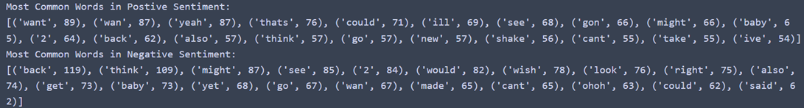
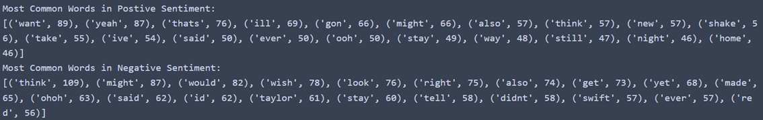
Further Loss Seeking
List of the most common words by label for the binary labels, looking at the data being used with the model. The top list shows the first list output, the second list shows the first list after modifying and removing cross label words by adding them to the stopwords dictionary. Model performance was slightly improved over base.

Slide 10
Conclusions and final thoughts
Model performance was on par with sentiment analysis results, both of which were below performance threshold.
Conflicting and contradictory statements within songs may be causing issues such as “I made up my mind im better off being alone” coming from a positive label and “All eyes on you my magician” coming from a negative label makes consistent weighting of words difficult as context changes per observation.
Limited dataset may be hindering performance and wider range of artist from an entire genre should have been selected in order to construct initial labels with fine tuning per artist later.
The analysis using individual features and word weighting may be erasing context from the statement in which the word was based, as such, a method that allows weighting of entire statements to retain some level of context may offer better performance.
While not the length of a novel, songs tend to be longer and more complex than reviews or tweets, which means that in reviews or tweet one point is usually focused on in a concise manner so extracting meaning is more straight forward than with songs which are longer and don’t necessarily focus on a theme using language consistent with that theme.

Slide 11


Thank You!
kdroller@syr.edu

